Slide 1
ONLINE PARKING APPLICATION development
Group # 5:
HEMANT CHOWDARY - 0788804
NISHI SHRIVASTAVA - 0770047
PRAYAS BALIYAN - 0790447
KIRAN PATHURI - 0788366
SAI KRISHNA - 0789428

Slide 2
Phase:1 INITIATION
Business case
Project charter
STAKE-HOLDERs REGISTER

Slide 3
Phase 1 INITIATION:
BUSINESS PROBLEM
As the total number of vehicles on Canada's roads increases, the demand for better and more efficient parking solutions is also increased.
Even if you have a space to park your car, you will waste a lot of time looking for that parking spot, which leads to higher fuel consumption and is not environmentally friendly.
OBJECTIVE
This Mobile application allows users to find the parking spot by just entering the current location or destination location where he wants to park their vehicle.
Our goal is to automate and reduce the time spent manually searching for the ideal parking spots.

Slide 4
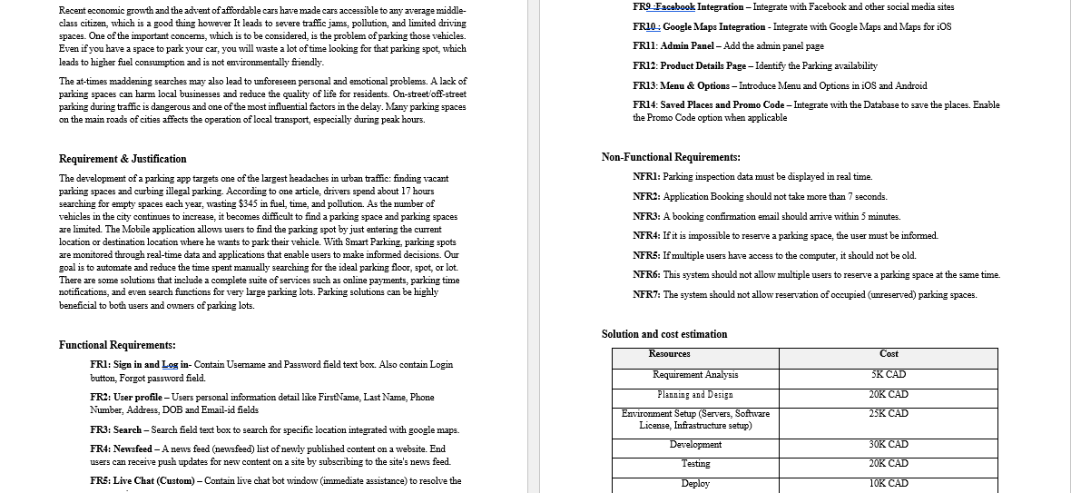
Business Case

Slide 5
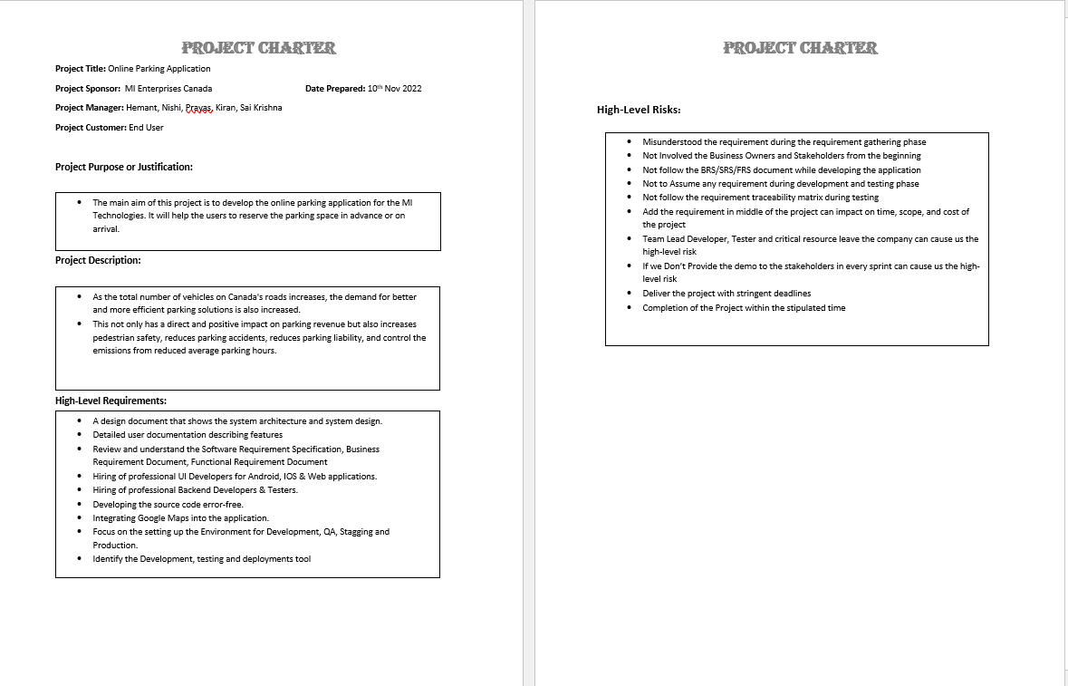
Project Charter: High Level PROJECT SCOPE
Monitor all the teams who involved to implement this parking application.
Identify the best tool for development, testing and deployment
Monitor the Development Activities
Monitor the Testing Activities
Monitor the deployment Activities

Slide 6
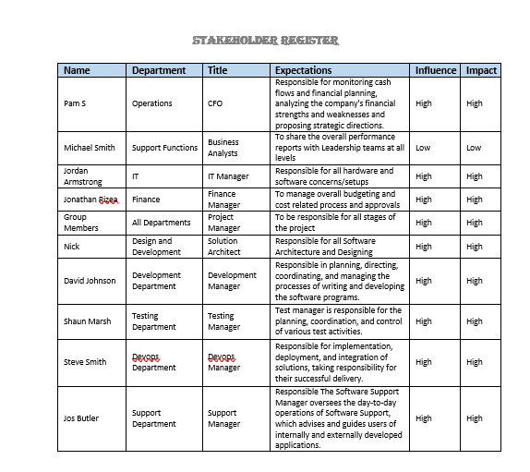
STAKE-HOLDERs REGISTER

Slide 7
Phase:2 planning
Project Management Plan
WBS
COST & BUDGET

Slide 8
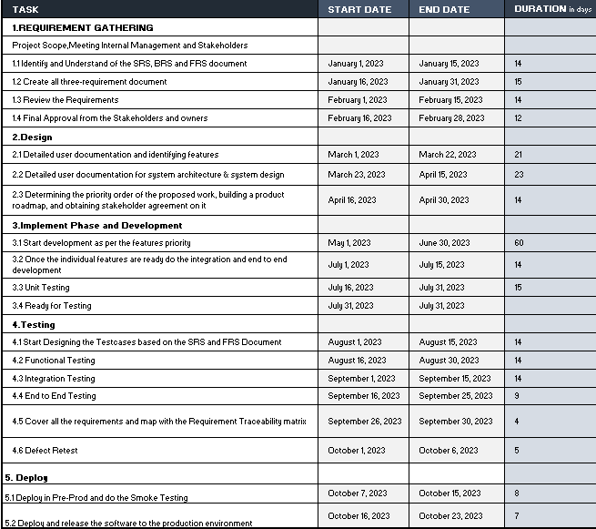
PHASE2: Planning Project Management Plan

Slide 9
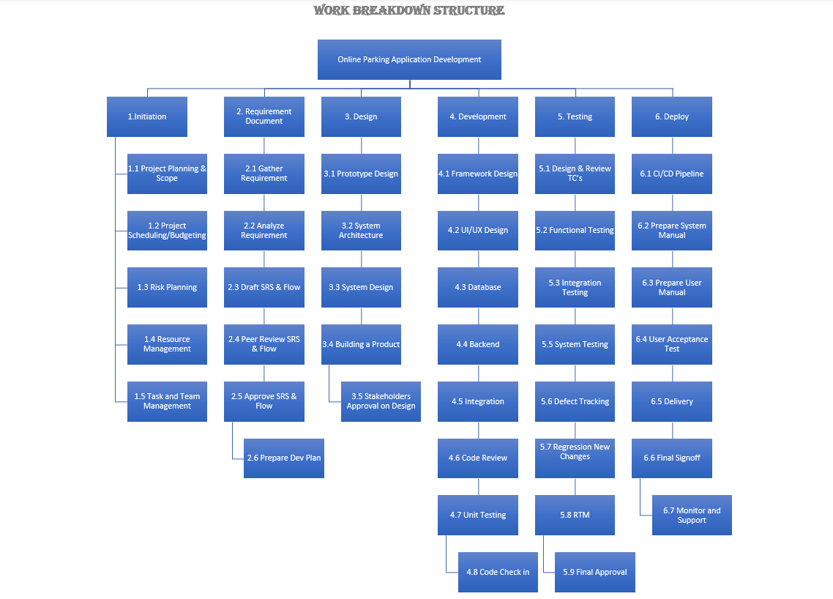
Work Breakdown Structure (WBS)

Slide 10
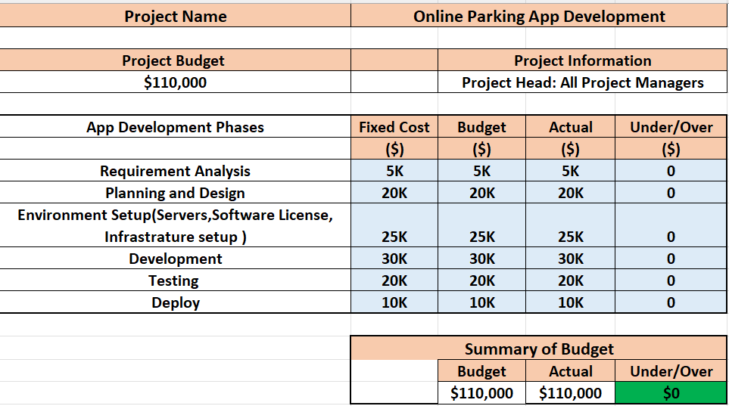
COST AND BUDGET

Slide 11
Phase:3 EXECUTION
PROJECT Timeline
GANTT CHART
COMMUNICATION PLAN

Slide 12
PHASE 3: execution
Project Timeline for Execution Phase

Slide 13
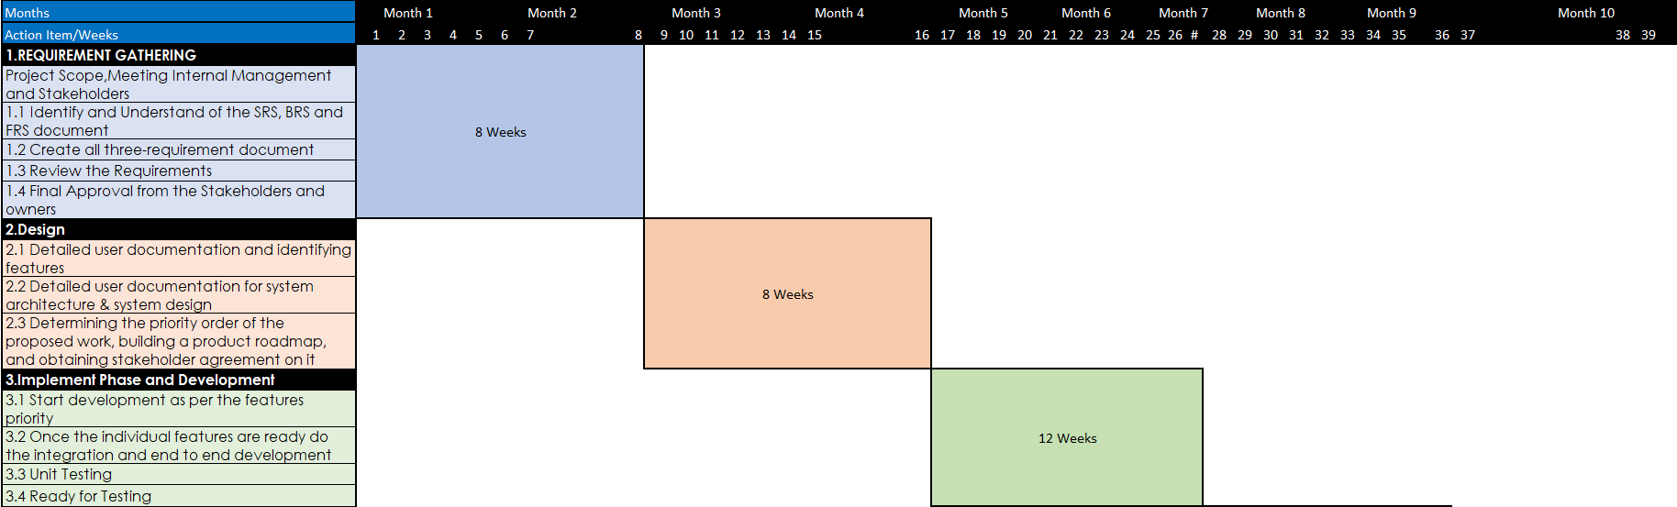
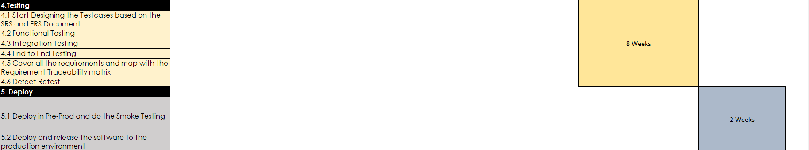
Gantt Chart

Slide 14
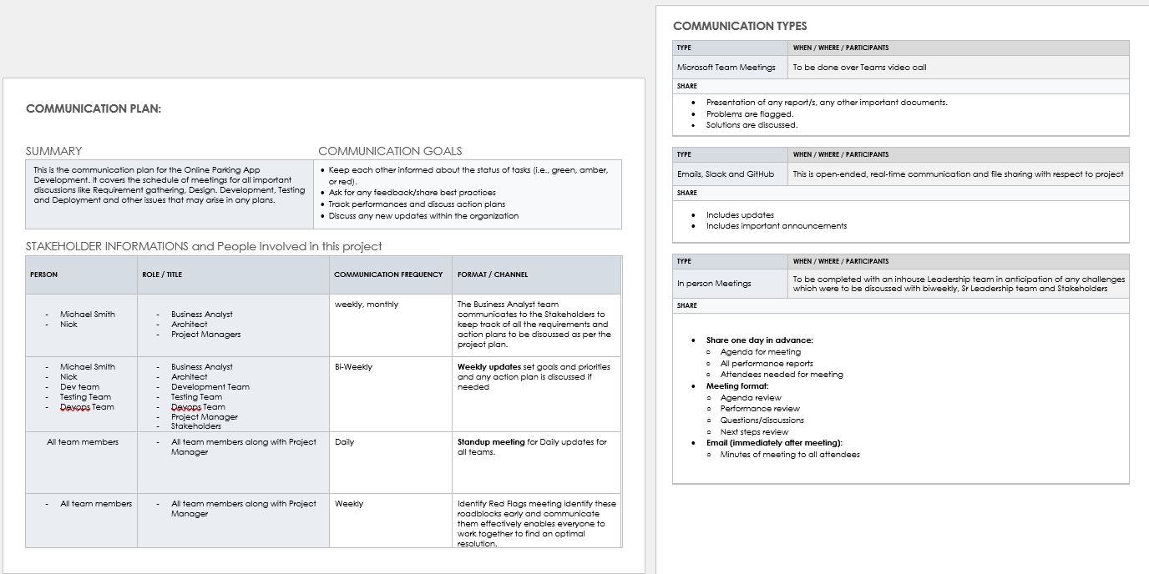
Communication Plan

Slide 15
Phase:4 CONTROL
RACI MATRIX
CHANGE REQUEST
CHANGE LOG

Slide 16
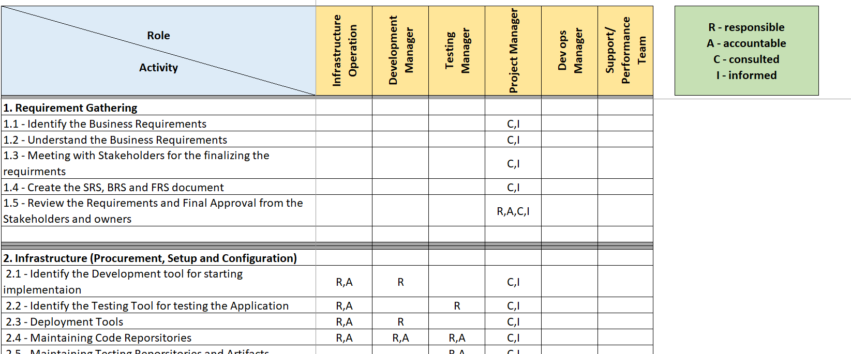
PHASE 4: Control
RACI MATRIX / KPI

Slide 17
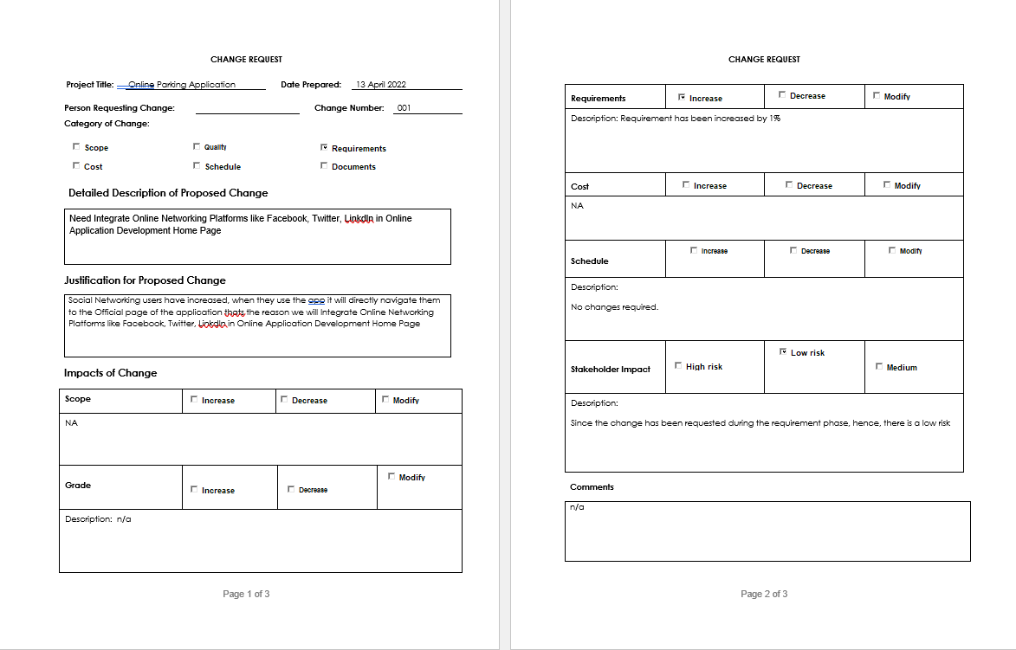
CHANGE REQUEST

Slide 18
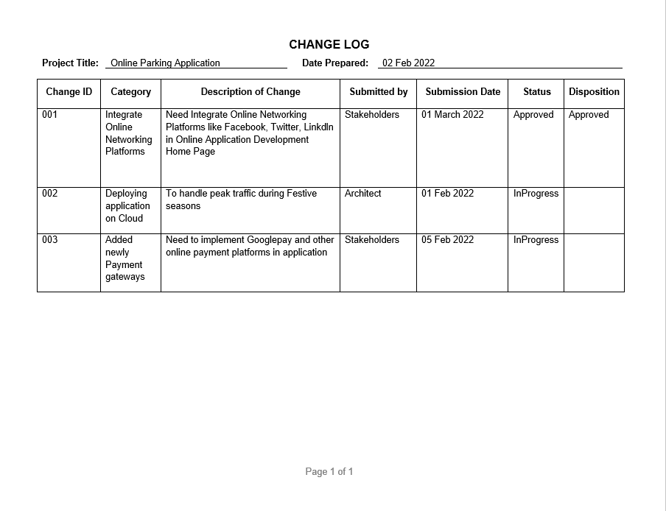
CHANGE LOG

Slide 19
Phase:5 CLOSE
LESSON LEARNED

Slide 20
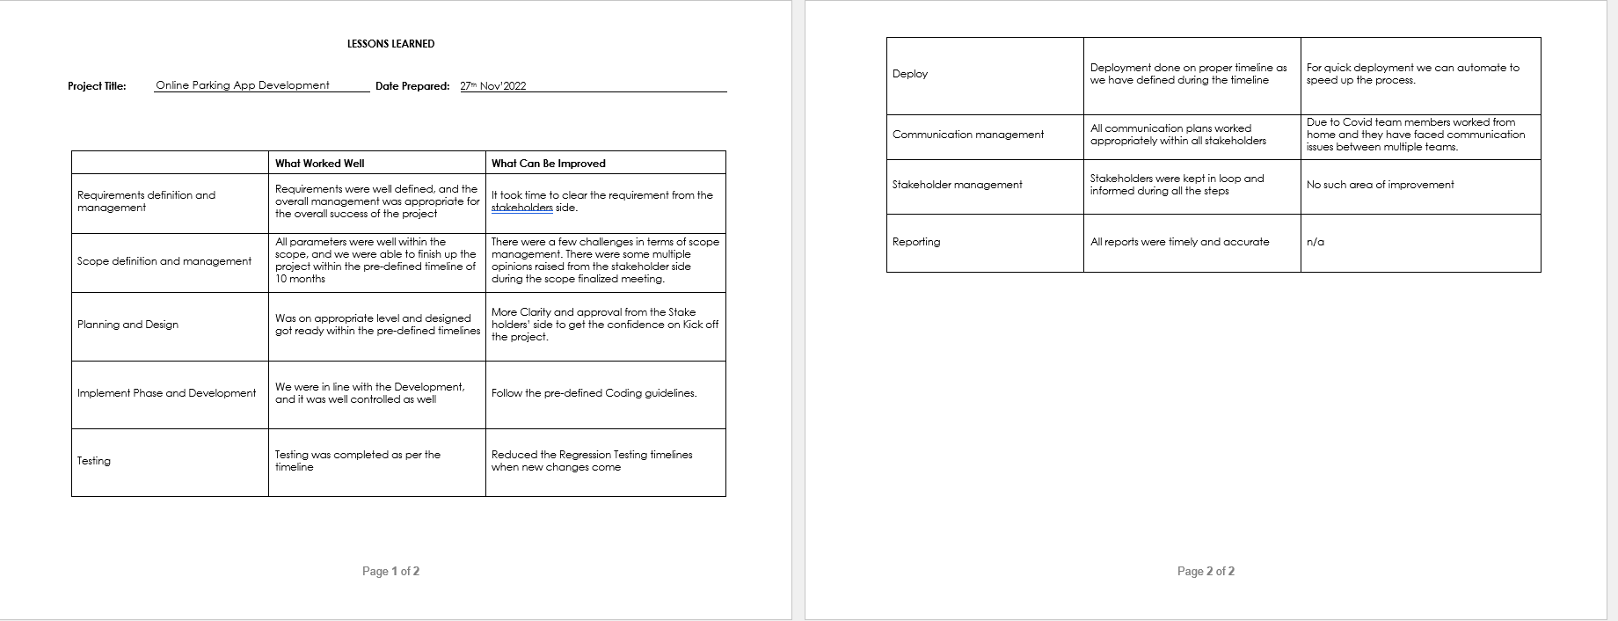
PHASE 5: CLOSE
LESSON LEARNED

Slide 21
Thank you
For THE SUPPORT & Guidance by PROF. HArprEEt VIRK.

